Slide 1
CSC371-Database Systems I Lecture-14 (Lab) (Fall2023)

Slide 2
Previous Lecture Review
SQL Stored Procedure

Slide 3
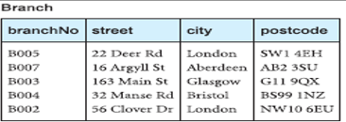
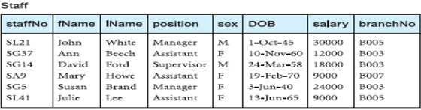
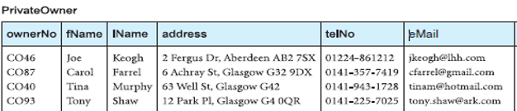
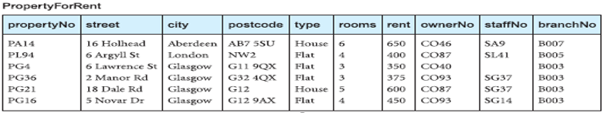

Slide 4
Agenda
SQL Server String Functions

Slide 5
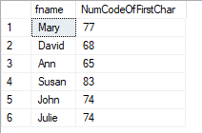
ASCII Character
SELECT fname, ASCII(fname) AS NumCodeOfFirstChar
FROM staff;

Slide 6

SQL Server CHAR() Function
SELECT CHAR(65) AS CodeToCharacter;

Slide 7

SQL Server CHARINDEX() Function
The CHARINDEX() function searches for a substring in a string and returns the position.
If the substring is not found, this function returns 0.
Note: This function performs a case-insensitive search.
CHARINDEX(substring, string, start)
SELECT CHARINDEX('mer', 'Customer', 3) AS MatchPosition;

Slide 8

SQL Server CONCAT() Function
CONCAT(string1, string2, ...., string_n)
SELECT CONCAT('SQL', 'is', 'fun!’);
SELECT CONCAT('SQL', ' ', 'is', ' ', 'fun!’);

Slide 9

SQL Server DATALENGTH() Function
The DATALENGTH() function returns the number of bytes used to represent an expression.
Note: The DATALENGTH() function counts both leading and trailing spaces when calculating the length of the expression.
DATALENGTH(expression)
SELECT DATALENGTH(‘ SQL is a fun ‘);

Slide 10
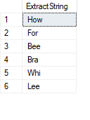
SQL Server LEFT() Function
The LEFT() function extracts a number of characters from a string (starting from left).
LEFT(string, number_of_chars)
SELECT LEFT(lname, 3) AS ExtractString FROM staff;

Slide 11

SQL Server LEN() Function
Count leading spaces but not trailing
SELECT LEN(' W3Schools.com ‘);

Slide 12

SQL Server LOWER() / UPPER() Function
SELECT LOWER('SQL Tutorial is FUN!’);
SELECT UPPER(‘sql tutorial is a fun’);

Slide 13

SQL Server LTRIM()/RTRIM() Function
The LTRIM() function removes leading spaces from a string.
The RTRIM() function remove trailing spaces from a string:
LTRIM(string)
SELECT LTRIM(' SQL Tutorial') AS LeftTrimmedString;

Slide 14
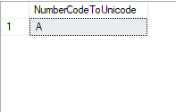
SQL Server NCHAR() Function
The NCHAR() function returns the Unicode character based on the number code.
NCHAR(number_code)
SELECT NCHAR(65) AS NumberCodeToUnicode;

Slide 15
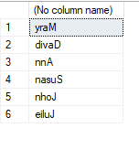
SQL Server REVERSE() Function
The REVERSE() function reverses a string and returns the result.
REVERSE(string)
SELECT REVERSE(fname) FROM staff

Slide 16
SQL Server SPACE() Function
The SPACE() function returns a string of the specified number of space characters.
SPACE(number)

Slide 17

SQL Server STR() Function
The STR() function returns a number as a string.
STR(number, length, decimals)
Number: Required. The number to convert to a string
Length: Optional. The length of the returning string. Default value is 10
Decimal: Optional. The number of decimals to display in the returning string. Default value is 0
SELECT STR(185.476, 6, 2);

Slide 18
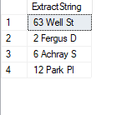
SQL Server SUBSTRING() Function
The SUBSTRING() function extracts some characters from a string.
SUBSTRING(string, start, length)
String: Required. The string to extract from
Start: Required. The start position. The first position in string is 1
Length: Required. The number of characters to extract. Must be a positive number
SELECT SUBSTRING(address, 1, 10) AS ExtractString FROM privateowner;

Slide 19
Summary
SQL Server String Functions

